Slide 1
AMBA 3 APB PROTOCOL
Prepared by: Mohamadadnan

Slide 2
Outline
Introduction
Signals
Block Diagram
Operating States
Transfers
Error Response

Slide 3
Introduction
APB – part of AMBA 3 protocol family.
Provides a low-cost interface that is optimized for minimal power consumption.
Unpipelined protocol
All signal transitions are only related to the rising edge of the clock.
Every transfer takes at least two cycles.
APB can interface with AMBA AHB and AMBA AXI

Slide 4
Signals
Signal | Source | Width
PCLK | Clock source | 1
PRESETn | System bus reset | 1
PADDR | Requester | ADDR_WIDTH
PSELx | Requester | 1
PENABLE | Requester | 1
PWRITE | Requester | 1
PWDATA | Requester | DATA_WIDTH
PREADY | Completer | 1
PRDATA | Completer | DATA_WIDTH
PSLVERR | Completer | 1

Slide 5
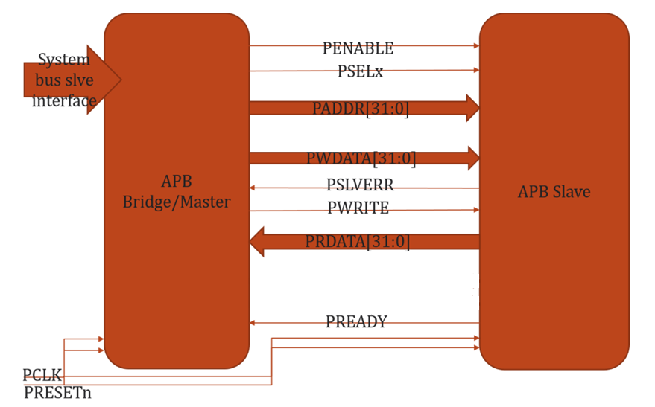
Block Diagram

Slide 6
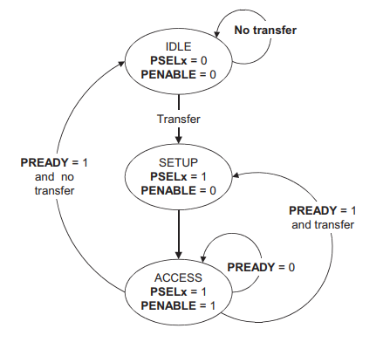
Operating States

Slide 7
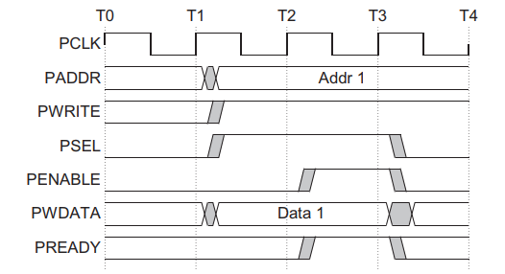
Write with no wait state

Slide 8
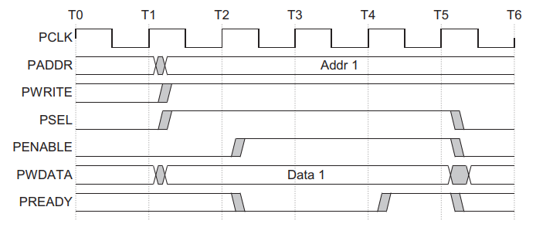
Write with wait state

Slide 9
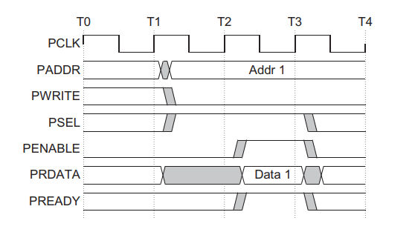
Read with no wait states

Slide 10
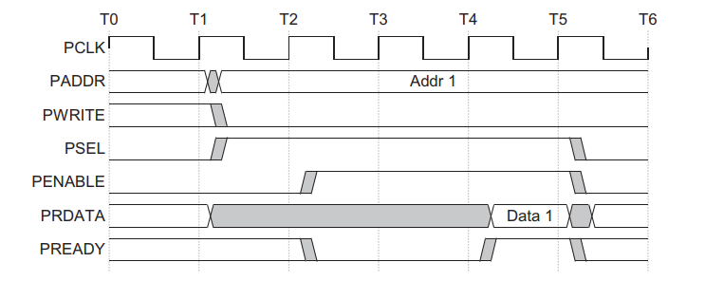
Read with wait states

Slide 11
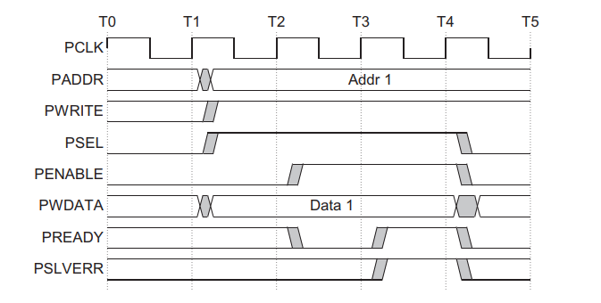
Error response for write transfer

Slide 12
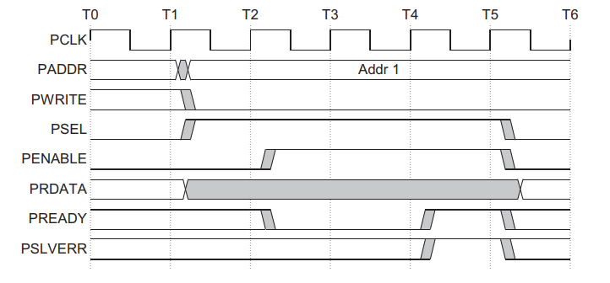
Error response for read transfer

Slide 13
THANK YOU

